Slide 1

CHAPTER 7
Mechanical Properties
of
Metals - II

Slide 2
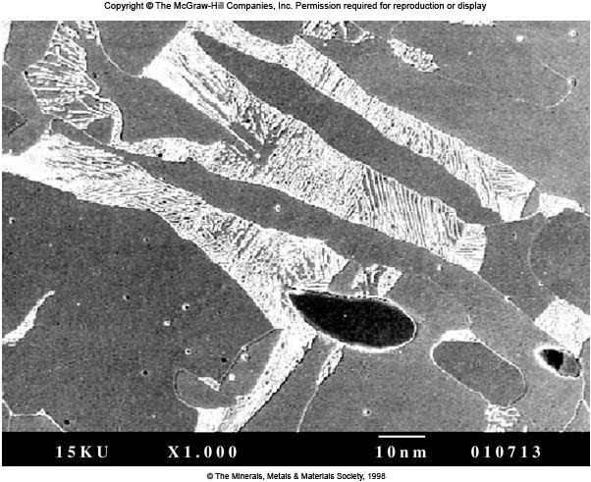
Microstructure of the Titanic Steel
On April 12, 1912, at 11:40 P.M., the Titanic struck a large iceberg (−2 °C sea water) and loss more than 1500 lives. The Titanic was found on the ocean floor (3700 m below) September 1, 1985 by Robert Ballard.
Based on metallurgical and mechanical tests performed
on the Titanic steel. Its ductile-brittle transition temperature was 32 °C (longitudinal) and 56 °C (transverse) and far beyond the sea water temperature. The microstructure shows ferrite grains (gray), pearlite colonies (light lamellar) and MnS particles (dark). This chap. presents fracture, fatigue, and creep properties of metals.

Slide 3
Fracture of Metals
Failure: Enable to (1) perform the intended function, (2) meet performance criteria, (3) perform safely and reliably. Including: yielding, wear, buckling, corrosion, fracture.
Safety factors, codes and standards are used and followed by all designer and manufactures. However, failures are unavoidable.
Engineer should be (1) completely familiar with the concept of failure of materials, (2) able to extract information from a failed component.
Failure analysis determine the cause of failure and advance safe performance and minimize the possibility of failure through improvements in design, selection, manufacturing and synthesis.
Engineers are concerned with fracture failure of design component.
Fracture results in separation of stressed solid into two or more parts. Ductile fracture vs. Brittle fracture
損壞
延性斷裂 vs. 脆性斷裂

Slide 4
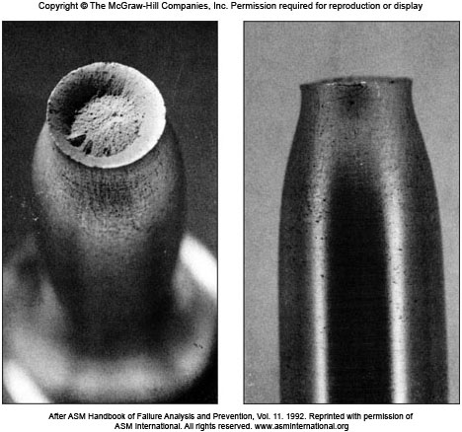
Ductile Fracture of Aluminum Alloy
Fig. 7.1 Ductile (cup-and-cone) fracture of an aluminum alloy tensile test specimen.

Slide 5
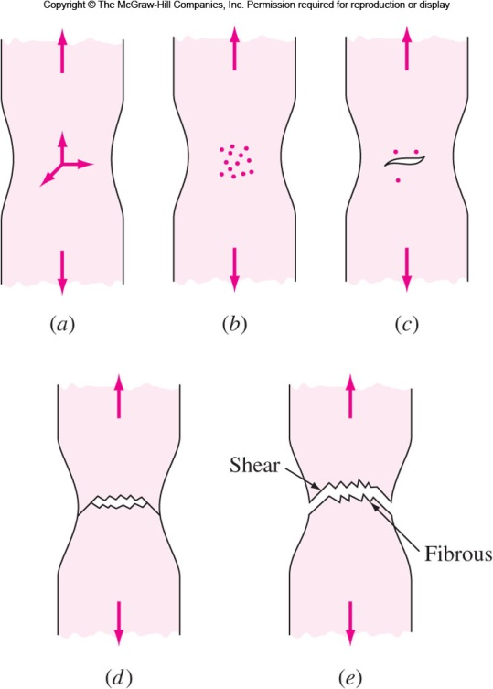
Cup-and-Cone Ductile Fracture
Three steps of ductile fracture:
(a, b) Specimen forms neck and cavities within neck.
(c) Cavities form crack and crack propagates towards surface, perpendicular to stress.
(d, e) When the crack nears the surface, direction of crack changes to 45° resulting in cup-and-cone fracture. 杯錐斷裂

Slide 6
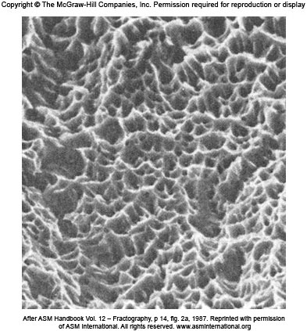
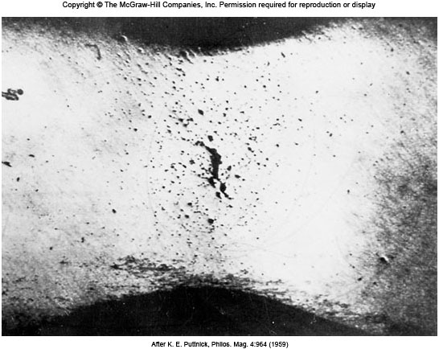
Ductile Fracture Structures
Fig. 7.3 SEM shows conical dimples in the fracture surface of a spring-steel.
Fig. 7.4 Internal cracking in the necked region of a polycrystalline specimen of high-purity copper. 9×
窩凹

Slide 7
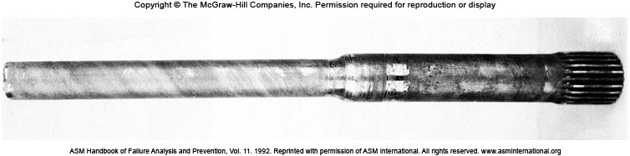
Ductile Fracture Case
Ductile fractures are less frequent than brittle fractures.
Overloading occur as a result of (1) improper design, (2) improper fabrication, or (3) abuse.
Fig. 7.5: A ductile failure of the rear axle shaft of a vehicle shows significant plastic twisting.
Specification: AISI S7 (Fe-0.55C-0.70Mn-3.25Cr-1.40Mo-0.25V-0.35Si). Hardness > 50 HRC. However, only 22-27 HRC from analysis. Heat treatment of this steel is required.
後車軸
Fig. 7.5 Failed axle shaft

Slide 8
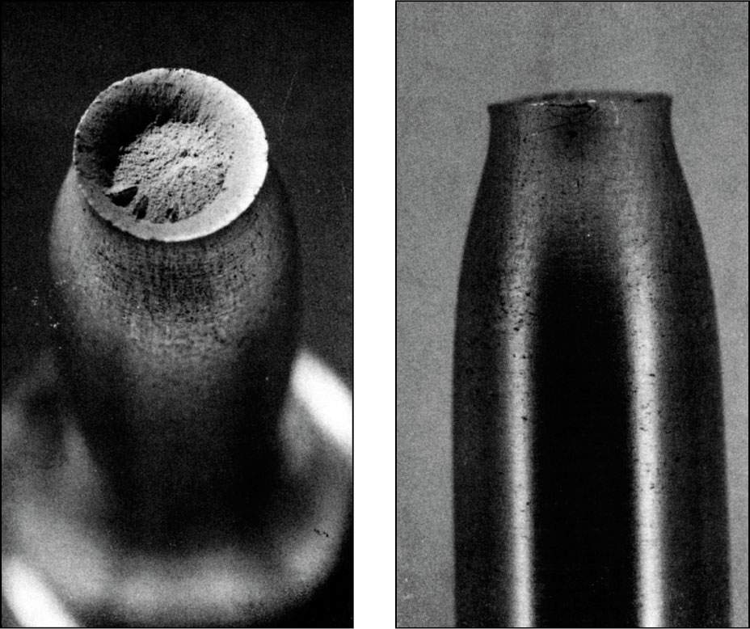
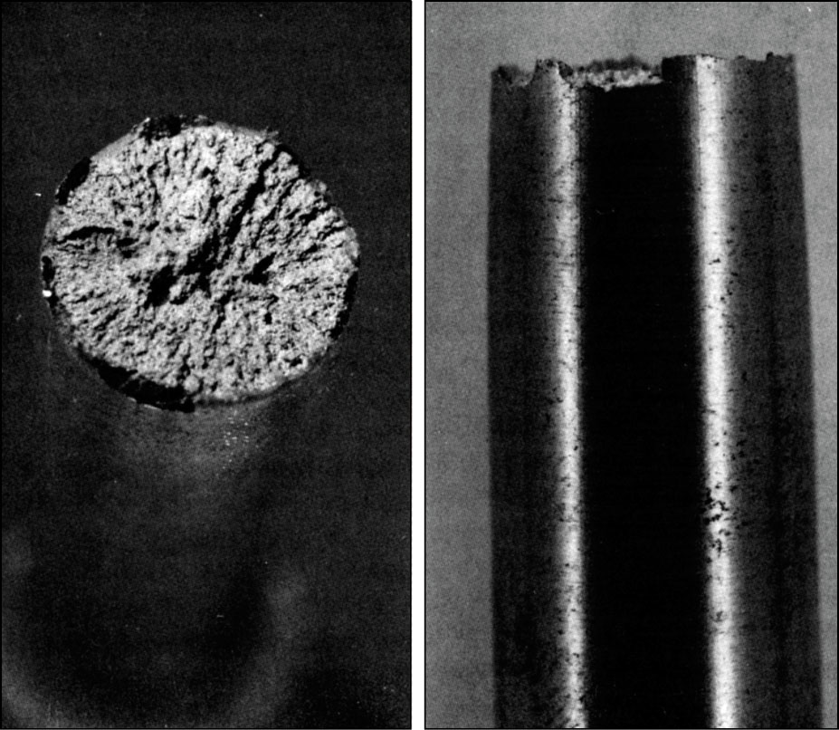
Ductile and Brittle Fractures
Ductile fracture
Brittle Fracture
No significant plastic deformation before brittle fracture.

Slide 9
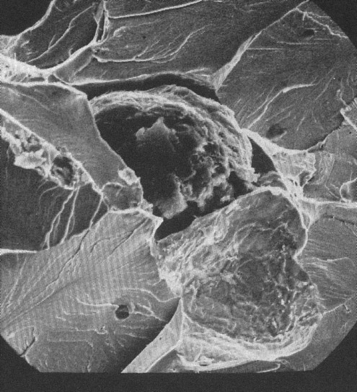
Brittle Fracture
Brittle fracture usually proceeds along specific cleavage planes, ⊥ stress.
Transgranular or Intergranular.
Three stages of brittle fracture :
Plastic deformation concentrates dislo- cation along slip planes at obstacles.
Microcracks nucleate due to shear stress where dislocations are blocked.
Crack propagates to fracture.
Examples: HCP Zinc single crystal under high stress along {0001} plane undergoes brittle fracture. BCC metals, α-Fe, Mo, W, fracture in brittle manner at high strain rates and low temperature.
Gr
BCC Fe
SEM of brittle fracture in ferritic ductile iron

Slide 10
Brittle Fractures (Cont..)
Brittle fractures are due to undesirable defects like
Manufacturing operations (casting, rolling…): Folds, Undesirable grain flow, Porosity, Tears and Cracks.
Services: Fatigue cracks, Corrosion damage, Embrittlement due to atomic hydrogen.
Brittle fracture initiates at defect location.
Low operating temperature, or high loading rates may cause the brittle fracture of some moderately ductile materials and ductile to brittle transition (DBT) takes place.

Slide 11
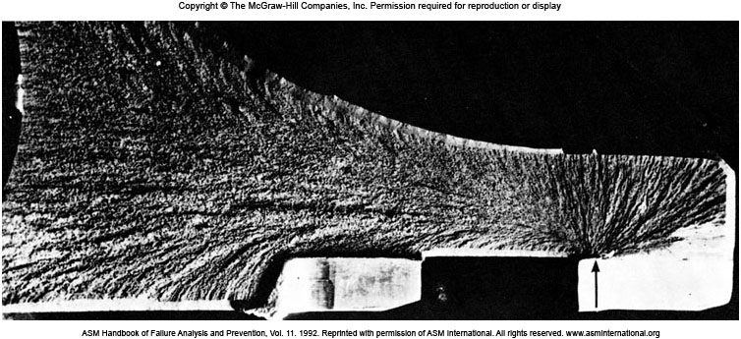
Brittle Fracture of a 4335 Steel Ring
擋圈
Fig. 7.8 A snap ring made of 4335 steel (Fe-0.35C-0.75Mn-0.50Si-1.8Ni-0.7Cr-0.3 Mo) failed in a brittle manner because of the existence of a sharp corner. The chevron pattern points toward the origin of the fracture (typically found in a brittle fracture surface.

Slide 12
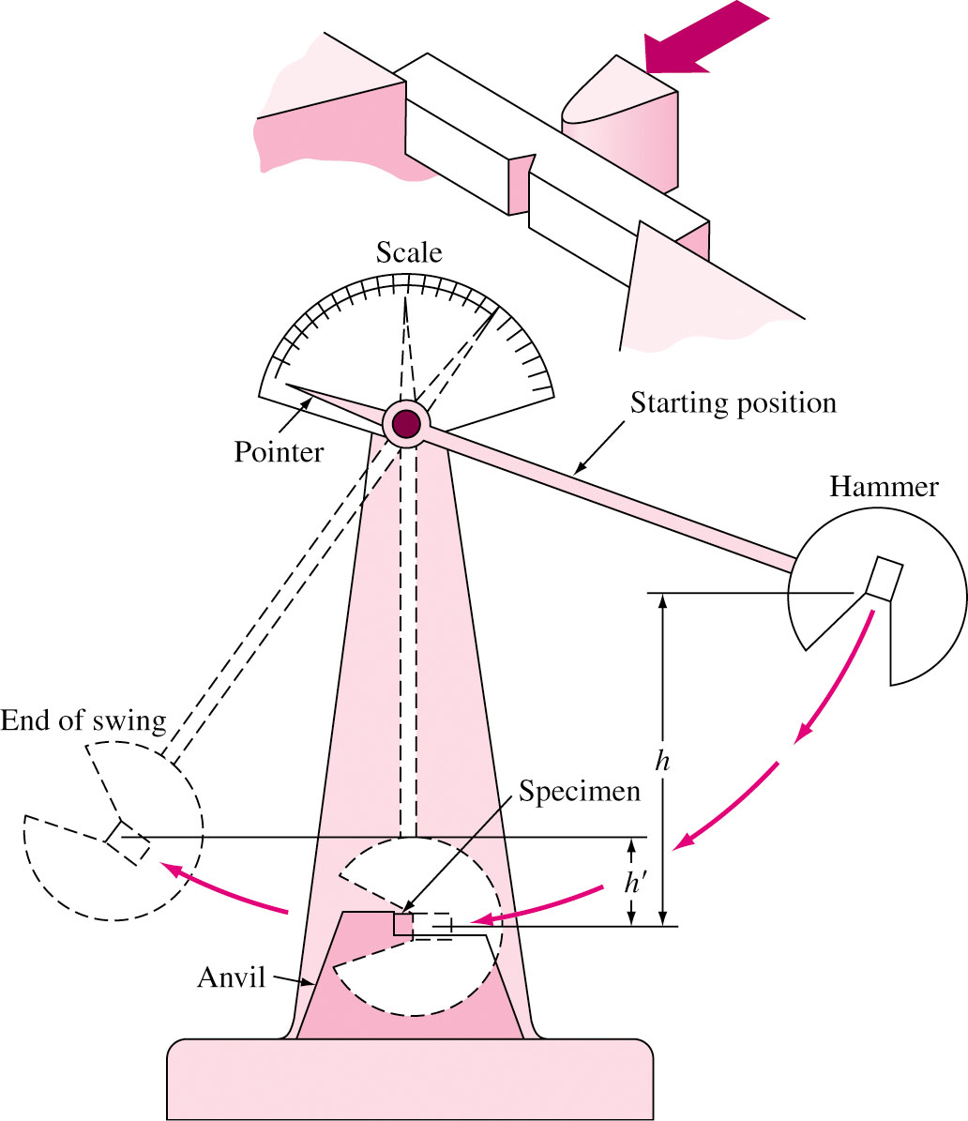
Toughness and Impact Testing
Toughness is a measure of energy absorbed before failure.
Impact test, one of the simplest methods of measuring toughness, measures the ability of metal to absorb impact.
Charpy V-notch Test: By knowing the mass of the pendulum and the difference between its initial and final heights, the energy absorbed by the fracture can be measured.

Slide 13
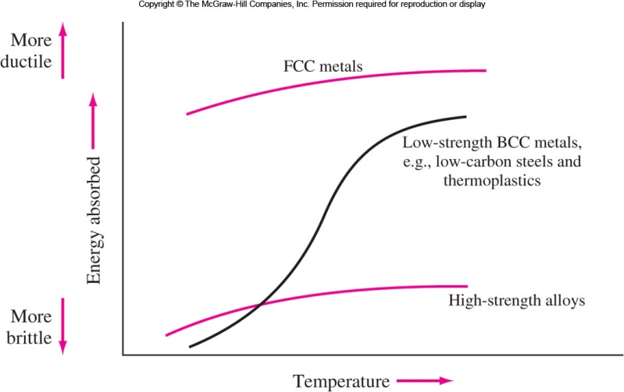
Temperature Effect on Impact Energy
Fig. 7.10 Effect of temperature on the energy absorbed upon impact by different types of materials.

Slide 14
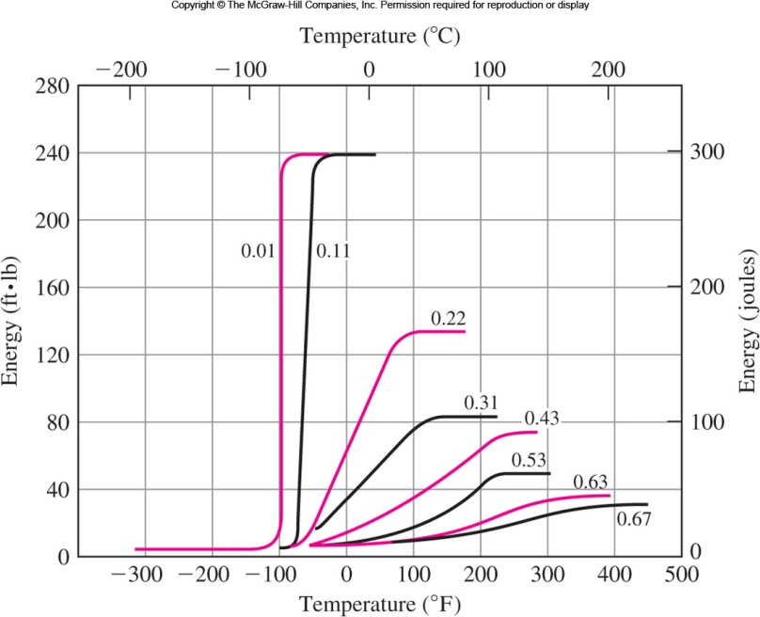
Ductile to Brittle Transition Temperature
延脆轉換溫度
15 ft-lb
20 J
Fig. 7.11 Effect of carbon content on the impact energy temperature plots for annealed steels.

Slide 15
Importance of the DBT Temperature
FCC metals do not undergo DBT and are suitable for low temperature use. 液態氮桶、液化天然氣運輸船
DBT temperature depends on: composition, heat treatment, processing.
DBT is important in materials selection for components that operate in cold environments.
The DBT temperature must be significantly lower than the operating or service temperature.
Sinking of Titanic: Titanic was made up of steel which has ductile-brittle transition temperature 32 °C. On the day of sinking, sea temperature was –2 °C which made the structure highly brittle and susceptible to more damage.

Slide 16
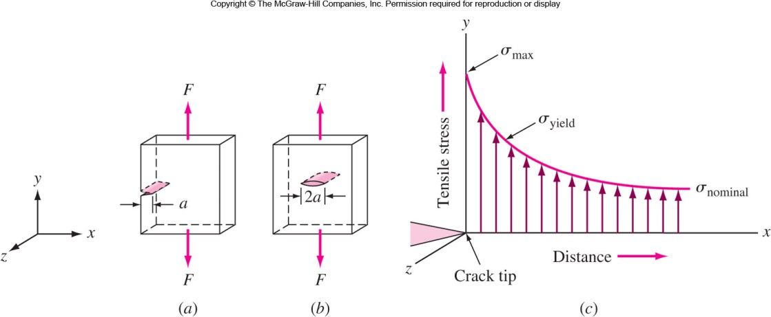
Fracture Mechanics 斷裂力學
Impact tests do not provide proper data for design purposes for material sections containing cracks or flows.
Fracture Mechanics provides the solution of this problem.
Fig. 7.12 Metal alloy plate under uniaxial tension (a) with edge crack a, (b) with center crack 2a. (c) Stress distribution versus distance from crack tip.

Slide 17
Fracture Toughness 斷裂韌性
Cracks and flaws cause stress concentration. “I” (mode one fracture): Crack surface ⊥ Stress axis
Fracture toughness K_{IC}: The critical value of stress intensity factor. SI units: MPa⋅m^{0.5} , ; USA:
應力強度因子
K_{I} = stress intensity factor
σ = applied stress
a = edge crack length
Y = geometric constant, ∼ 1
Example:
Al 2024 T851 26.2 MPa⋅m^{0.5}
4340 alloy steel 60.4 MPa⋅m^{0.5}

Slide 18
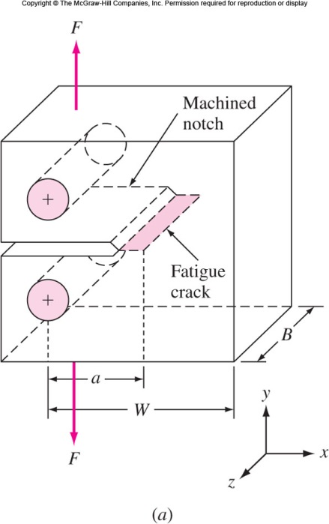
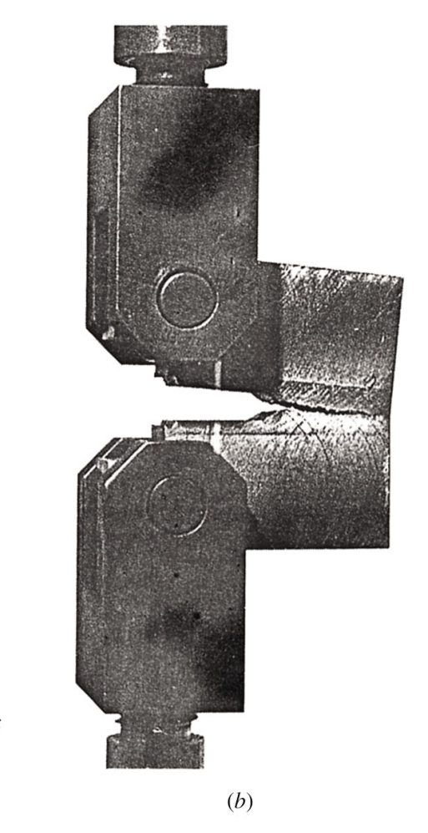
Measuring Fracture Toughness
~ 3 mm
B ≥ 2.5 (K_{IC}/Yield Strength)²
Fig. 7.13 Fracture toughness test using a compact type of specimen and plain-strain conditions

Slide 19
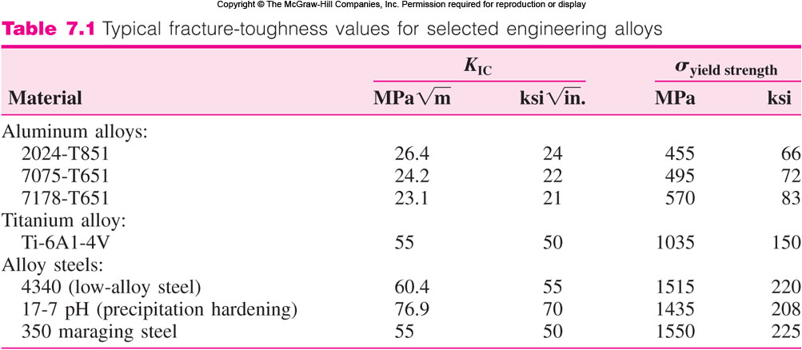
Fracture Toughness Data
A notch is machined in a specimen of sufficient thickness B.
Plain strain condition: B ≥ 2.5 (K_{IC}/Yield Strength)²
Specimen is tensile tested. Higher the K_{IC} value, more ductile the metal is. Used in design to find allowable flaw size.

Slide 20
EP. 7.1 A structural plate component of an engineering design must support 207 MPa in tension. If aluminum alloy 2024-T851 is used for this application, what is the largest internal flaw size that this material can support? (Use Y = 1)

Slide 21
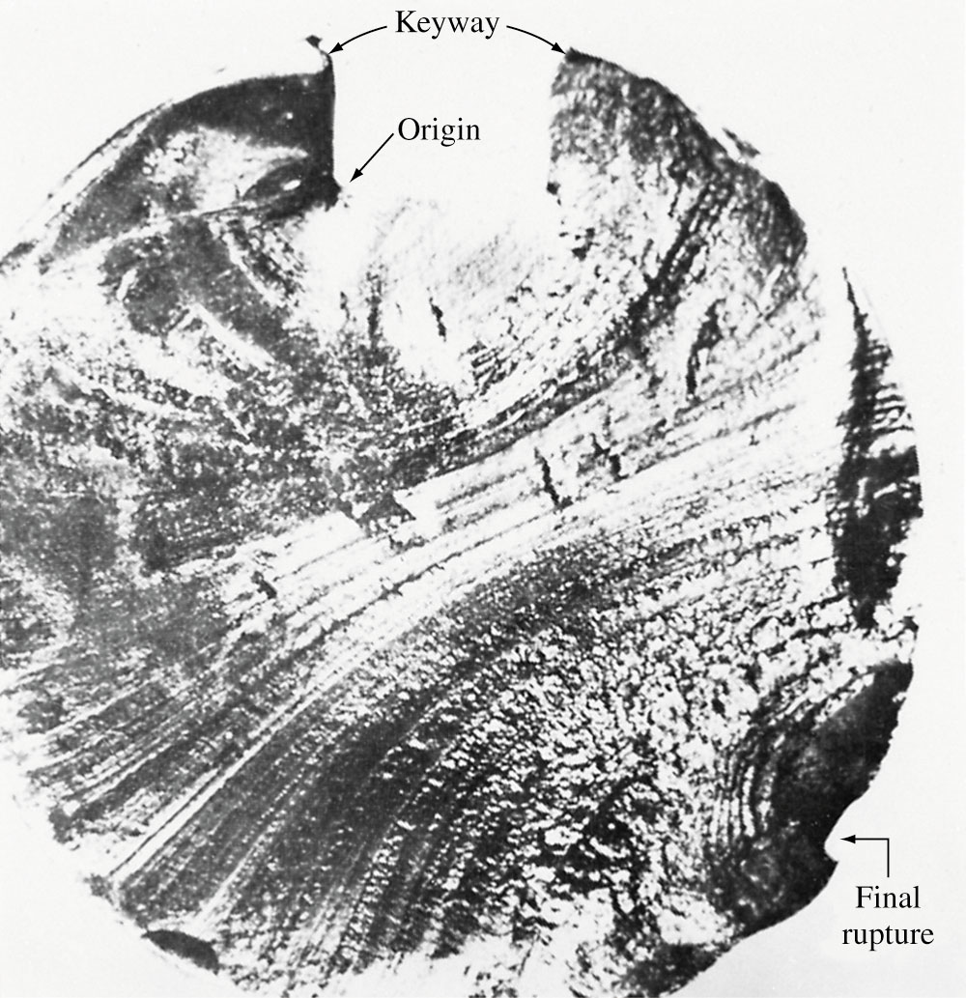
Fatigue of Metals 金屬疲勞
Metals often (80%) fail at much lower stress at cyclic loading (Fatigue Failure) compared to static loading.
1. Crack nucleates at region of stress concentration (sharp corner, notch inclusion or flaw) and propagates due to cyclic loading.
2. Clamshell or “beach” markers are created. (smooth region)
3. Failure occurs when cross sectional area of the metal too small to withstand applied load. (rough surface area)
蛤殼或海灘條紋
Fracture started here
Fig. 7.14 Fatigue fractured surface of keyed shaft (1040 steel, HRC30). OM
鍵軸
Final rupture

Slide 22
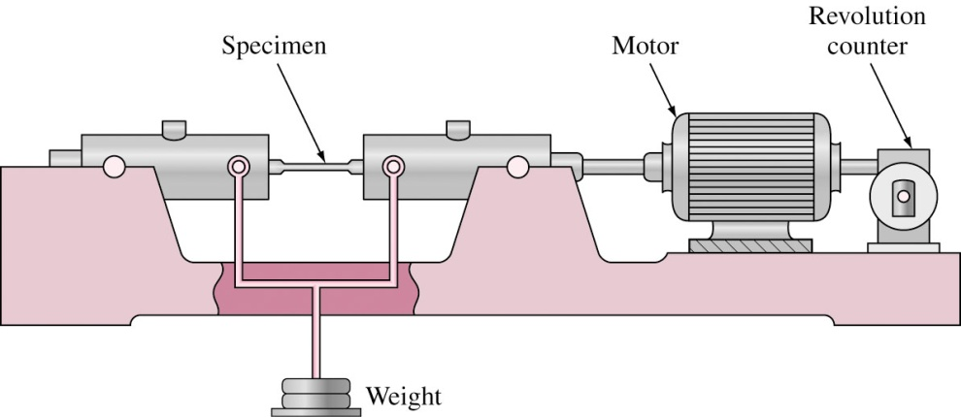
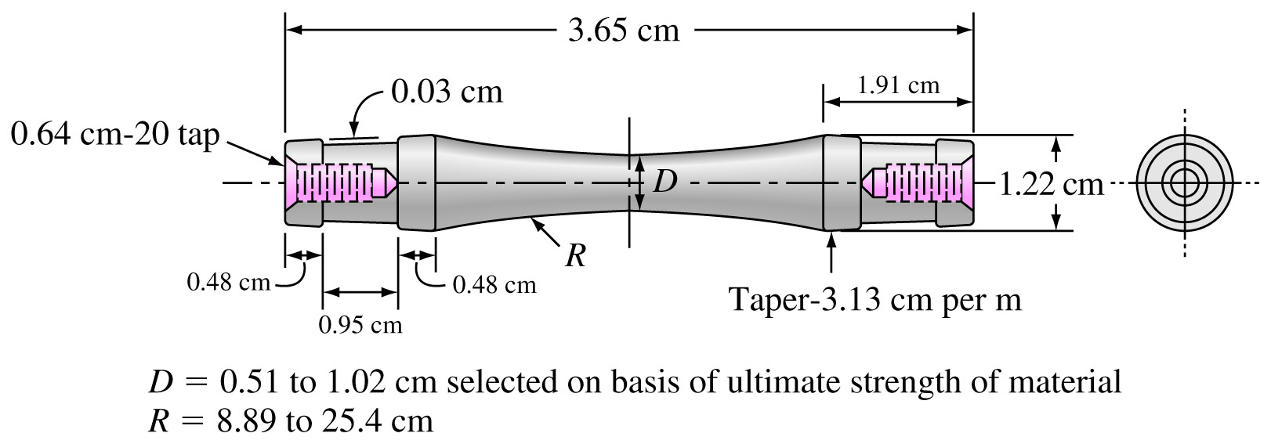
Rotating-Beam Fatigue Test
This part of the specimen is in compression
This part of the specimen is in tension
9.00 cm
Compression
Tension

Slide 23
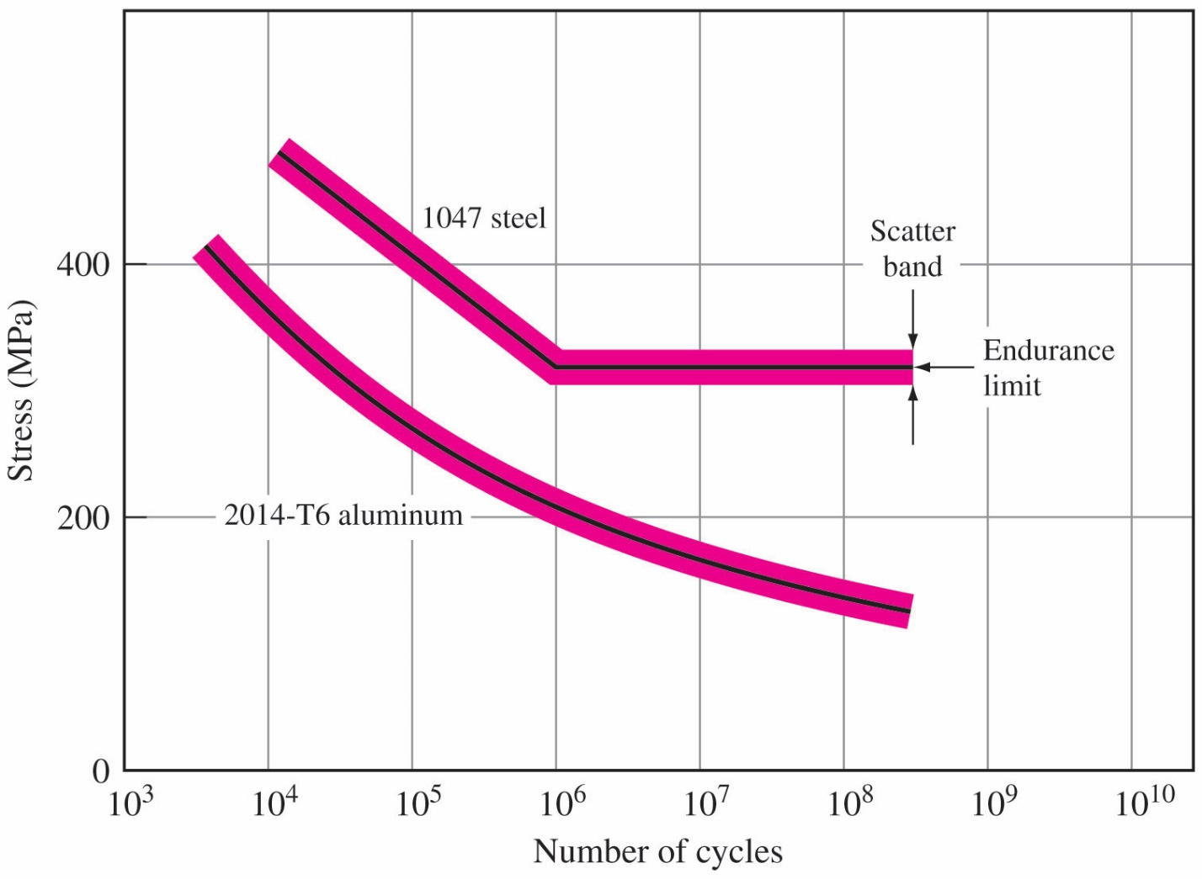
Fatigue SN Curves
Alternating compression and tension load is applied on metal piece tapered towards center.
Stress to cause failure S and number of cycles required N are plotted to form SN curve.
Endurance limit of ferrous alloys is about one-half their UTS.
Fatigue strength of Al alloys is about one-third their UTS.
疲勞限
疲勞強度
Fatigue Strength, ~ 3 × 10⁷ cycles
23

Slide 24
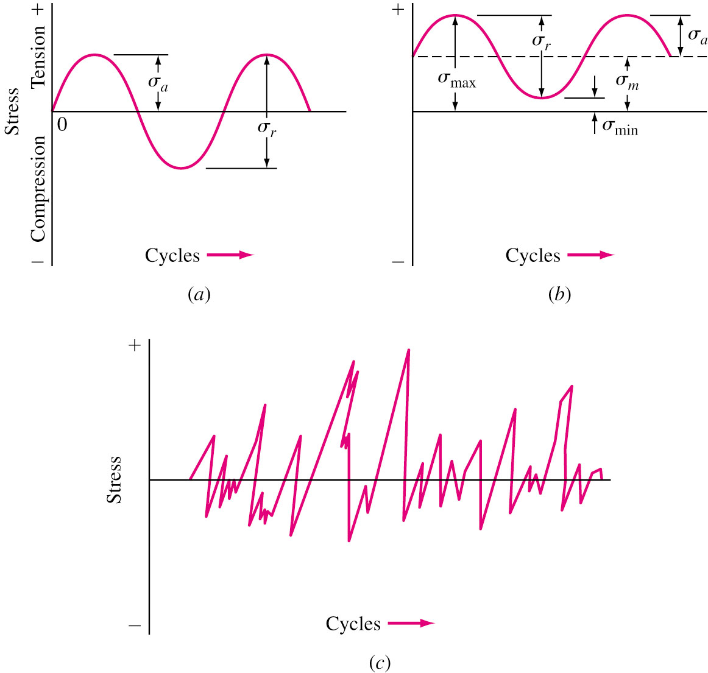
Cyclic Stresses
Different types of stress cycles are possible (axial, torsional and flexural).
Mean stress =
Stress range =
Stress amplitude =
Stress ratio =
Fig. 7.19 (a) Completely reversed stress cycle, as a rotating shaft operating at constant speed or rotating beam fatigue test. (b) Reversed stress cycle with σ_{m} ≠ 0. (c) Vary randomly in amplitude and frequency.

Slide 25
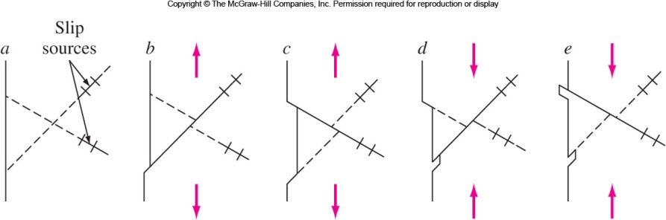
Structural Changes in Fatigue Process I
Crack initiation first occurs.
Slipband crack growth: Reversed directions of crack initiation caused surface ridges and groves called slipband extrusions and intrusions as well as persistent slipbands (PSB) within the metal. Cracks are formed at or near the surface and propagate into metal along shear planes. This is stage I and is very slow (10⁻¹⁰ m/cycle).
持續滑移帶
2
2
1
1
Fig. 7.20 Mechanism for the formation of slipband extrusions and intrusions.

Slide 26
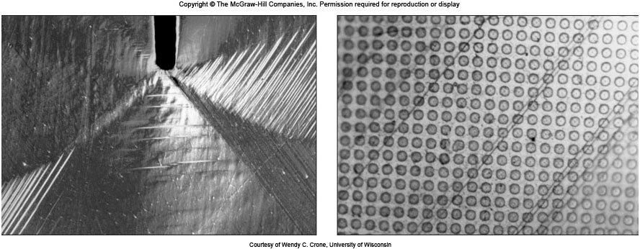
Structural Changes in Fatigue Process II
Persistent slip bands in copper crystal
Slipbands cut and shift the surface polymer dots
3. Stage II: Crack growth changes direction to be perpendicular to maximum tensile stress (rate: ~ microns/sec). Fatigue striations are created as the crack advances and can indicate the origin and direction of crack propagation.
4. Ultimate ductile failure: cross-sectional area is too small to withstand the stress.
疲勞條紋

Slide 27
Factors Affecting Fatigue Strength
Stress concentration: Fatigue strength is reduced by stress concentration. Avoided notches, keyways, or sharp changes in cross sections.
Surface roughness: Smoother surface increases the fatigue strength. Rough surfaces create stress raisers.
Surface condition: Most fatigue failure originate at the surface. Surface treatments like carburizing and nitriding increases fatigue life. Compressive residual stress on the surface also increases fatigue life.
Environment: Chemically reactive environment, which might result in corrosion, decreases fatigue life. It is known as “Corrosion Fatigue.”
滲碳滲氮

Slide 28
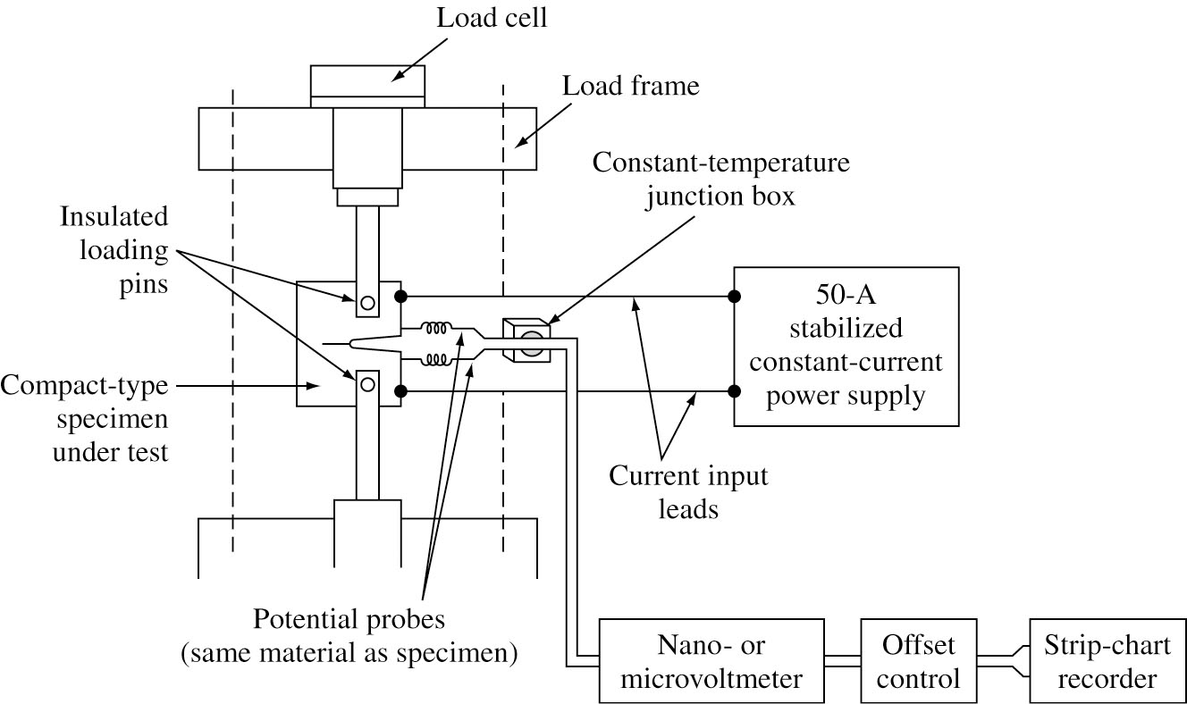
Fatigue Crack Length Measurement
V = I R ⇒ A ↓ ⇒ R ↑ ⇒ V ↑
Fig. 7.22 The direct-current electrical potential crack monitoring system for the high-cycle fatigue testing of a compact test sample.

Slide 29
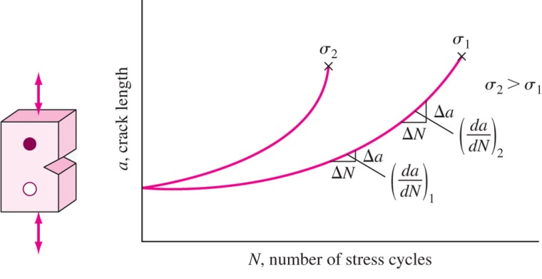
Fatigue Crack Propagation Rate I
Notched specimen used.
Cyclic fatigue action is generated.
Crack length is measured by change in potential produced by crack opening.
When ‘a’ is small, da/dN
is also small.
da/dN increases with inc-
reasing crack length.
Increase in σ increases
crack growth rate.

Slide 30
Fatigue Crack Propagation Rate II
= fatigue crack growth rate, mm/cycle or in./cycle
ΔK = stress intensity factor range,
A, m = Constants depending on material, environment, frequency,
temperature and stress ratio.
30

Slide 31
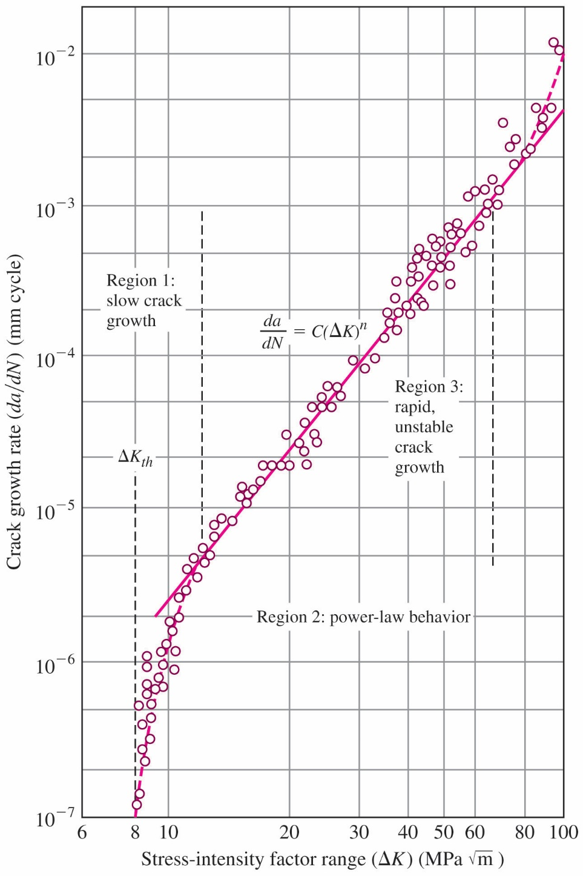
Fatigue Crack Propagation Rate III
Straight line with slope m
Region I: da/dN very slow
Region II: da/dN = A ΔK^{m} Straight line
Region III: Unstable
Limiting value of ΔK below
which there is no measurable
crack growth is called stress
intensity factor range
threshold ΔK_{th}
ASTM A533 B1: Fe-0.22C-1.48Mn-0.68Ni-0.52Mo-0.25Si-0.018S-0.012P
YS = 470 MPa, R = 0.10.
31

Slide 32
Fatigue Life Calculation I
But
Therefore
Therefore
Integrating from initial crack size a₀ to final crack size a_{f}
at number of fatigue cycles N_{f}
32

Slide 33
Fatigue Life Calculation II
EP. 7.2 An alloy steel plate (YS = 1400 MPa, K_{IC} = 450 MPa⋅m^{0.5}) is subjected to cyclic stresses of 120 MPa and −30 MPa. If the plate contains a uniform through thickness edge crack of 1.00 mm, how many fatigue cycles are estimated to cause fracture? da/dN (m/cycle) = 2.0 × 10⁻¹² ΔK³ ( MPa⋅m^{0.5})³; Y = 1.

Slide 34
da/dN (m/cycle) = 2.0 × 10⁻¹² ΔK³ ( MPa⋅m^{0.5})³
Thus, A = 2.0 × 10⁻¹², m = 3, and σ_{r} = (120−0) MPa, Y = 1.
The initial crack size a₀ = 1 mm, a_{f} is determined from
The fatigue life in cycles is determined from

Slide 35
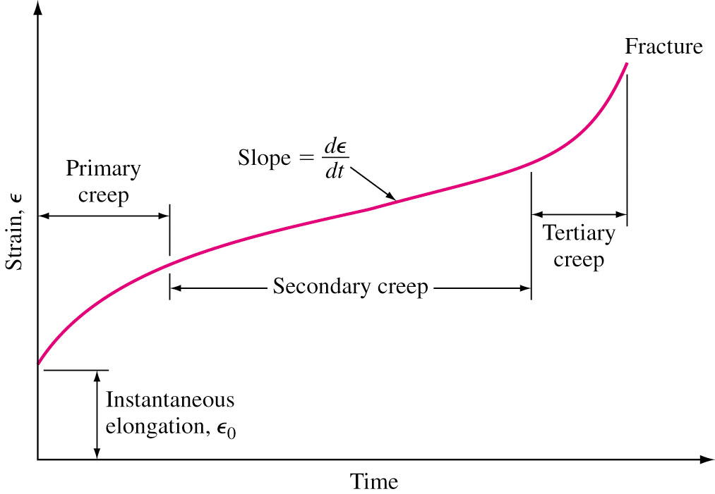
Creep in Metals 金屬潛變
Creep is progressive plastic deformation under constant stress.
Important in high temperature applications. Turbine Blades.
First an instantaneous strain ε₀ after loading.
Primary creep: Creep rate (dε/dt) decreases with time.
Secondary creep: Creep rate is constant and is also referred to steady-state creep.
Tertiary creep: Creep rate rapidly increases with time leading to necking and fracture.
Fig. 7.25 A typical creep curve for a metal.

Slide 36
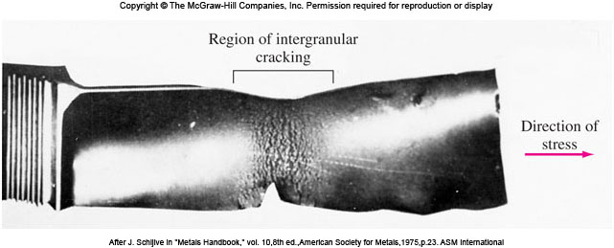
Three Creep Stages
Primary creep: The metals strain-hardens to support the applied load and the creep rate decreases gradually.
Secondary creep: Creep rate is constant (and minimum) due simultaneous strain hardening and recovery process involving highly moving dislocations at higher temperature (> 0.5 T_{m}).
Tertiary creep: The creep rate accelerates due to necking of the specimen and also to the formation of voids.
Fig. 7.26 A jet engine blade that has undergone creep deformation causing local deformation and a multiplicity of intergranular cracks.

Slide 37
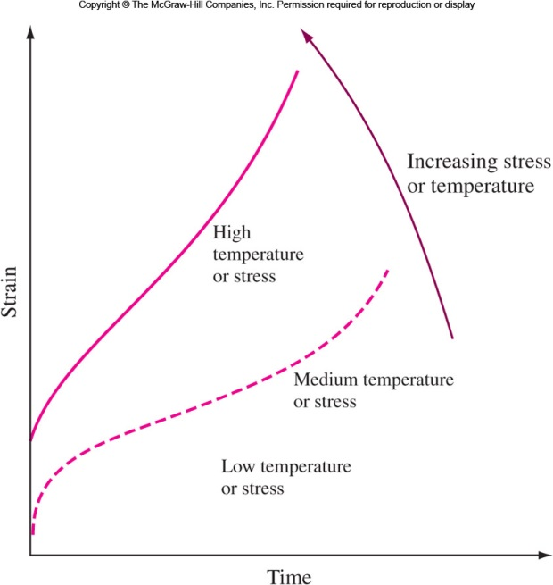
Creep Test I
Creep test determines the effect of temperature and stress on creep rate.
Metals are tested at constant stress at different temperature or constant temperature with different stress.

Slide 38
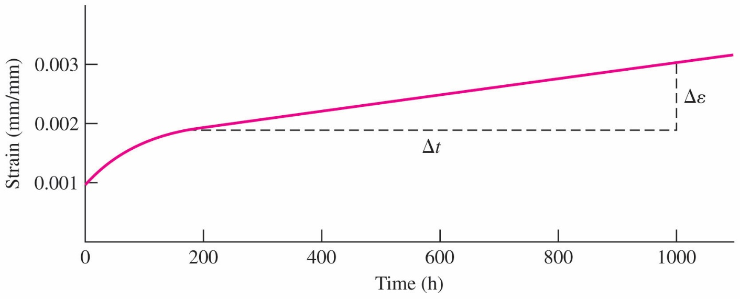
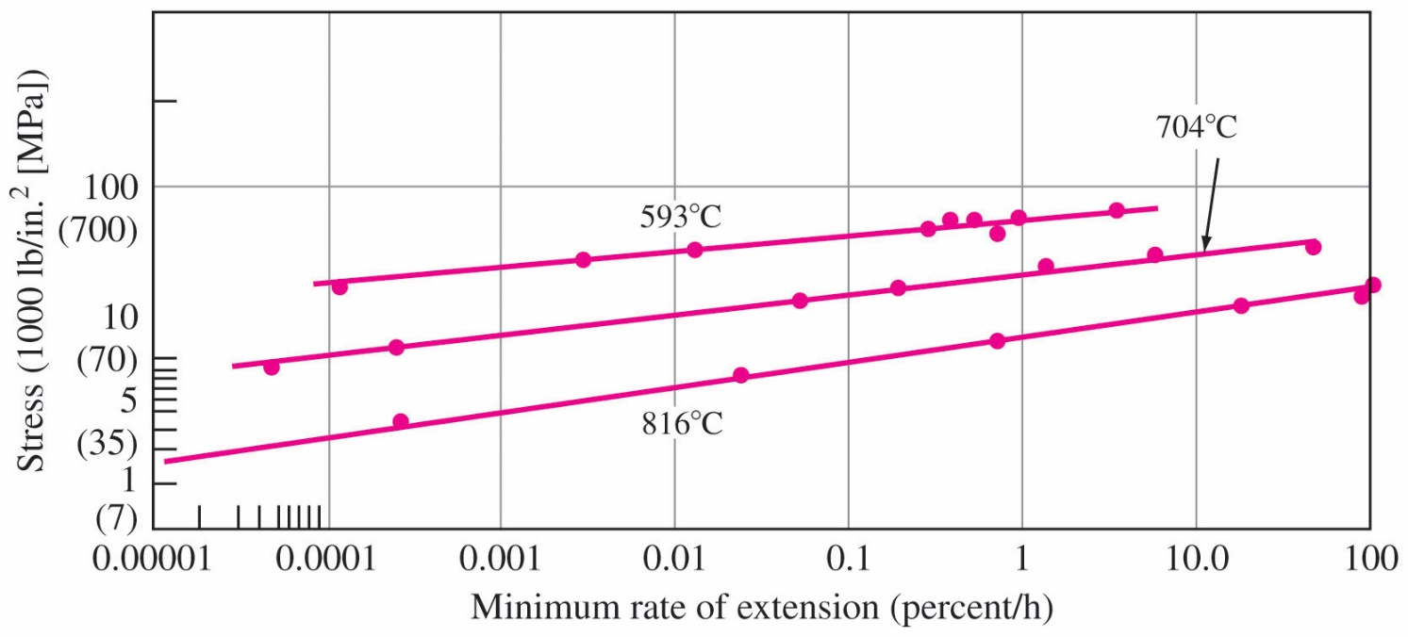
Creep Test II
Fig. 7.28 Creep curve for a copper alloy tested at 225 °C and 230 MPa. The slope of the linear part of the curve is the steady-state creep rate.
Fig. 7.29 Effect of stress on the creep rate of 316 stainless steel (Fe-18Cr-12Ni-2.5Mo) at various temperatures.
Creep strength: Stress to produce minimum creep rate of 10⁻⁵ %/h at a given temperature.
38

Slide 39
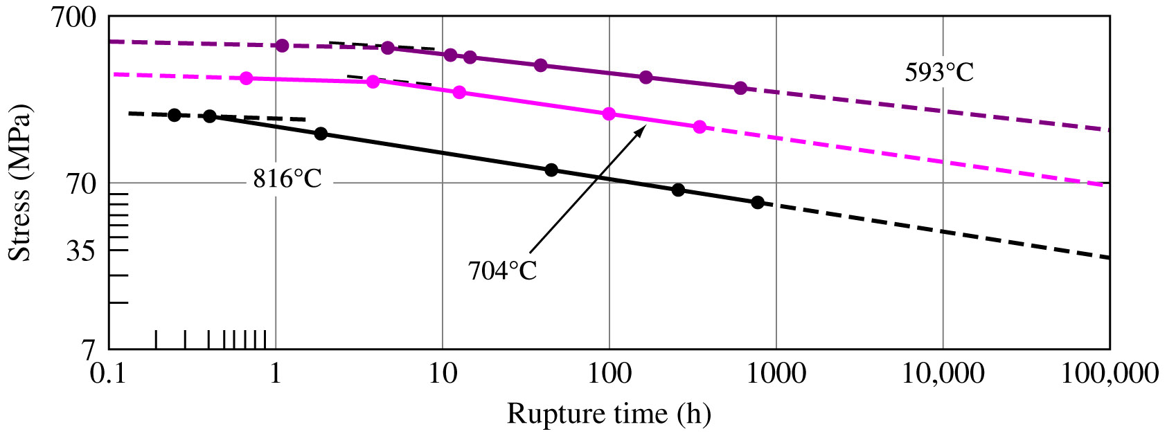
Creep-Rupture Test 潛變破裂試驗
Creep rupture test is same as creep test but aimed at failing the specimen. Plotted as log stress versus log rupture time.
Time for stress rupture decreases with increased stress and temperature. Slope changes are caused by recrystallization, oxidation, corrosion, or phase changes.
Fig. 7.30 Effect of stress on the time to rupture of type 316 stainless steel (Fe-18Cr-12Ni-2.5Mo) at various temperatures.
39

Slide 40
Larsen-Miller Parameter I
Larsen Miller (L.M.) parameter is used to represent creep-stress rupture data.
P(L.M.) = T [log t_{r} + C]
T = temperature, K or °C; t_{r} = stress-rupture time, h
C = Constant (order of 20)
Also, P(L.M.) = [T(°C) + 273](20 + log t_{r})
or P(L.M.) = [T(°F) + 460](20 + log t_{r})
At a given stress level, the log time to stress rupture plus constant multiplied by temperature remains constant for a given material.

Slide 41
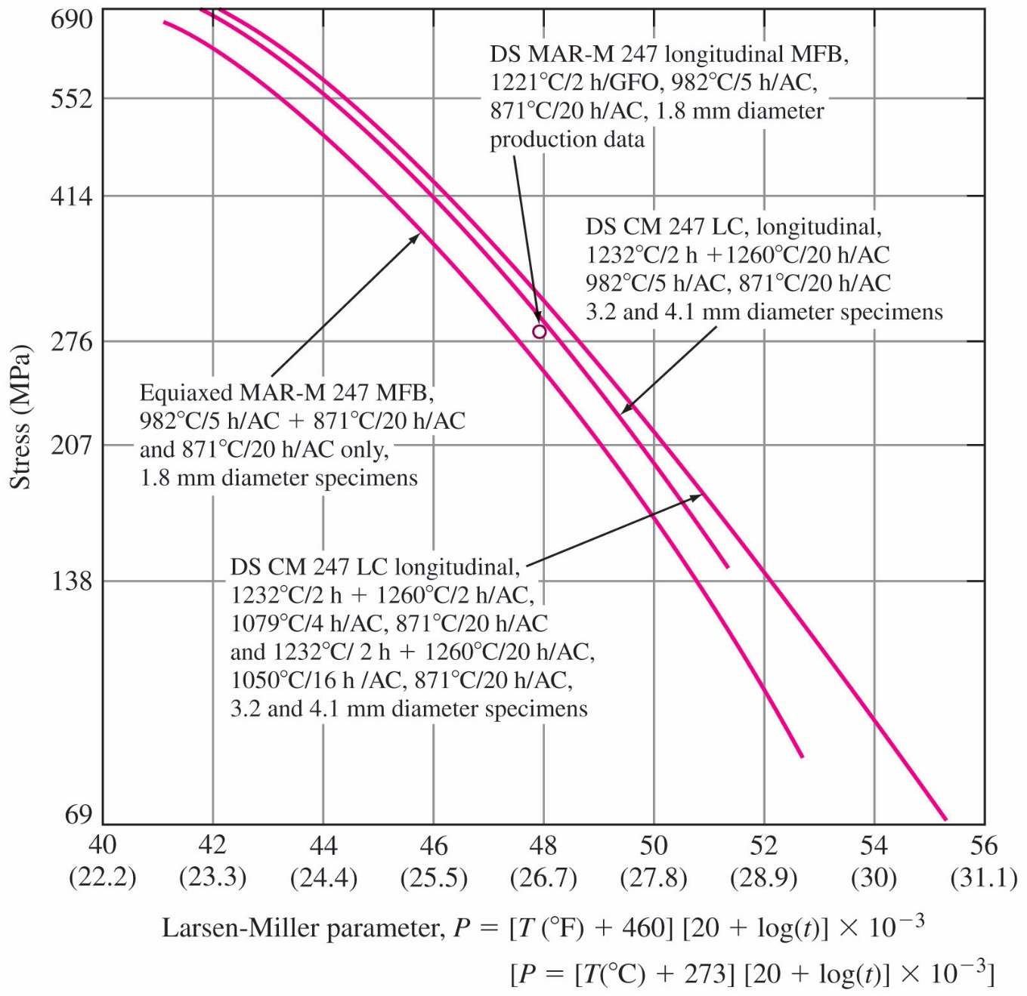
Larsen-Miller Parameter II
If two variables of time to rupture, temperature and stress are known, 3rd parameter that fits L.M. parameter can be determined.
Example:
For alloy CM, at 207 MPa, L.M. parameter is 27.8 × 10³ K. Then if temperature is 980 °C,
time to rupture t_{r}
27.8 × 10³ = (980+273) (20 + log t_{r}) t_{r} = 155 h.
41

Slide 42
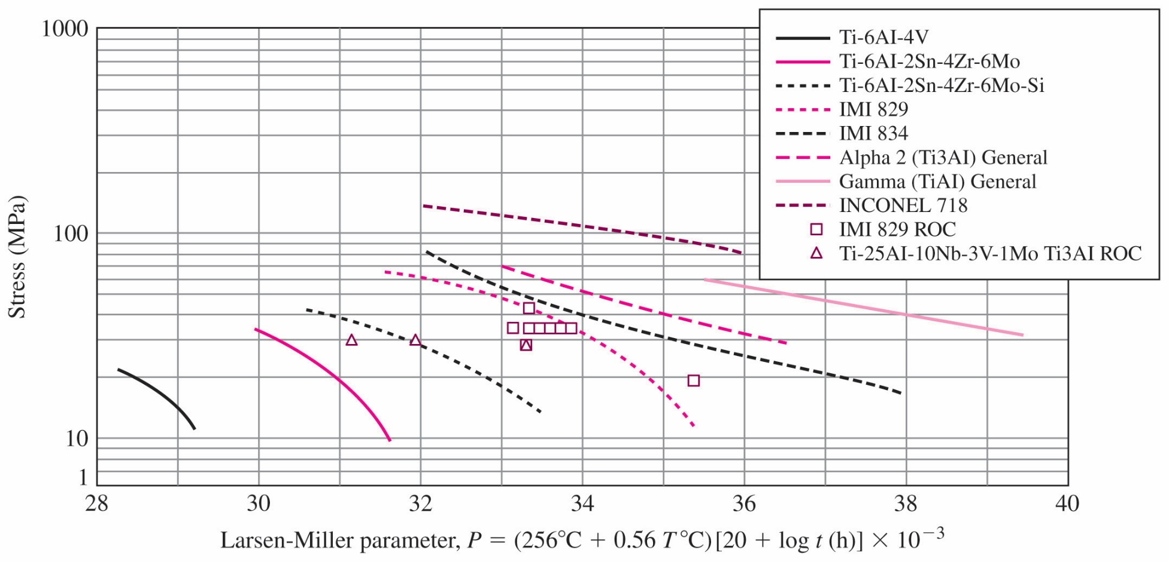
L.M. Diagram of Several Alloys
Ti₃Al
TiAl
Stress (ksi)
40
L.M. diagram for 0.2% strain.
P = [T°(F )+ 460] [20 + log t (h)] × 10⁻³
Example: Calculate time to cause 0.2% creep strain in gamma
titanium aluminide at 40 ksi and 1200 °F
From Figure, P = 38000 = (1200 + 460) (20 + log t) 22.89 = 20 + log t ⇒ log t = 2.89 ⇒ t = 776 h
42

Slide 43
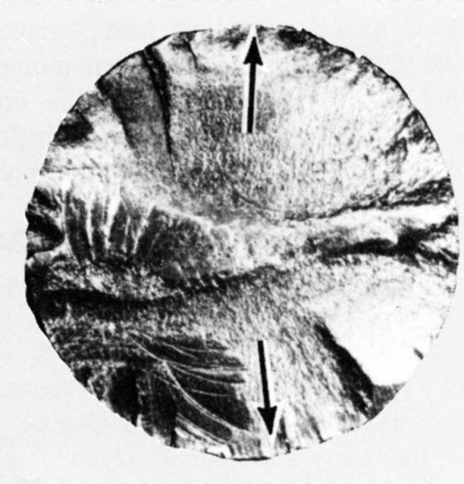
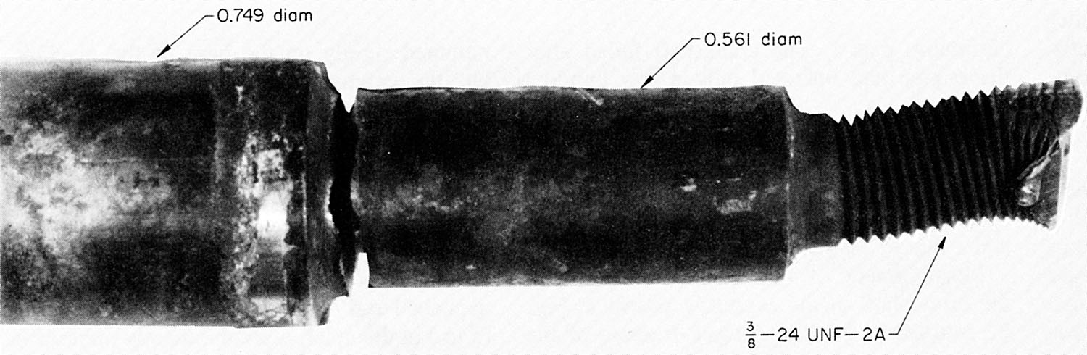
Case Study – Analysis of Failed Fan Shaft
Requirements
Function – Fan drive support
Material 1040 or 1045 cold drawn steel
Yield strength – 586 MPa
Expected life – 6440 km (failed at 3600 km)
Visual examination (avoid additional damage)
Failure initiated at two points near fillet
Characteristic of reverse bending fracture

Slide 44
Failed Shaft – Further Analysis
Chemical analysis revealed that it was in fact 1040 steel.
Tensile test (specimen out of the center of the fractured shaft) proved yield strength to be 369 MPa (UTS: 631 MPa, Elongation: 27%), lower than specified 586 MPa.
Metallographic examination revealed grain structure to be equiaxed (cold drawn metal has elongated grains).
Conclusion: Material is not cold drawn – it is hot rolled!
Lower fatigue strength and stress raiser caused the failure of the shaft.
This case study shows the importance of the engineer’s knowledge of material properties, processing techniques, heat treatment, and selection in the successful design and operation of components.

Slide 45
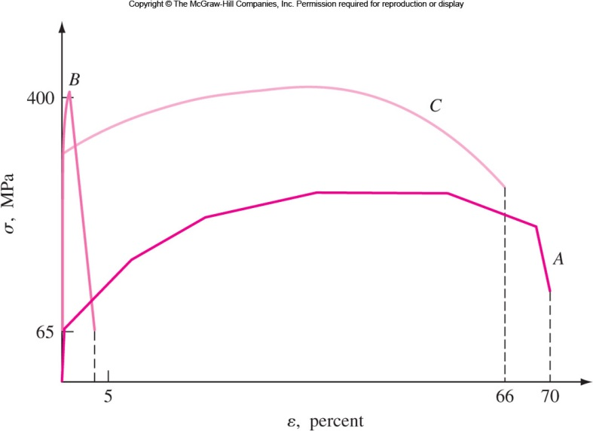
Recent Advances: Strength + Ductility
Coarse grained – Low strength (65 MPa), high ductility (~70%)
Nanocrystalline – High strength (400 MPa), low ductility (< 5%, because of failure due to localized tiny shear bands). Low ductility results in reduced toughness and therefore minimized practical applications of these nano materials.
Fig. 7.35 The stress strain diagrams for microcrystalline (curve A), nanocrystalline (curve B), and mixed grain (curve C) pure copper.

Slide 46
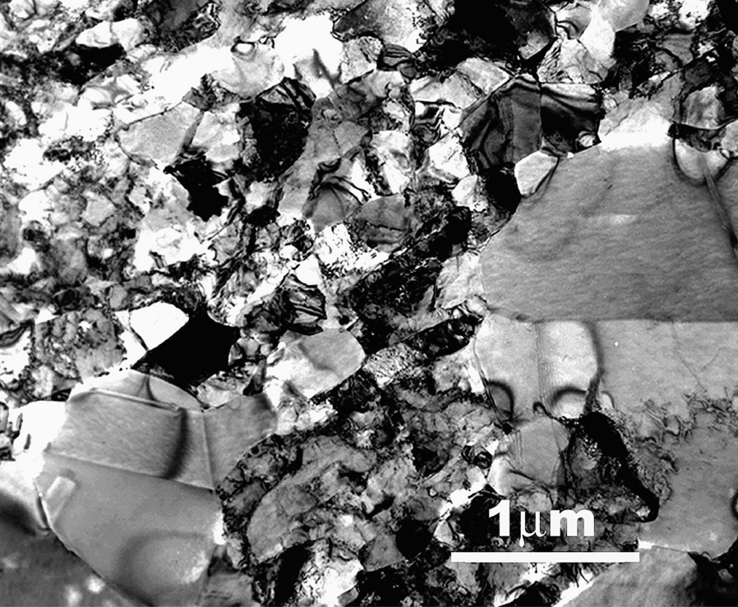
Mixture of Micro- and Nanosized Grains
Ductile nanocrystalline copper: Can be produced by
Cold rolling at liquid nitrogen temperature,
Additional cooling after each pass,
Controlled annealing.
Cold rolling creates disloca- tions and cooling stops recovery.
25% micrometer-sized grains in a matrix of nano- meter and ultrafine grains.
Fig, 7.36 A TEM micrograph showing the mixture of micro-, ultrafine-, and nanosized grains in pure copper

Slide 47
Mixed Grain Mechanism
Cold-rolling process in liquid nitrogen temperature, again and again: A large density of dislocations are formed and cannot to recovery. This severely deformed sample has a mixture of nanocrystalline and ultrafine grain structure.
Controlled annealing: Some grains allows recrystallization and abnormal grain growth to 1-3 μm.
The existence of the large grains allows an elevated level of dislocation and twinning activity and provides the deformation ability while the predominantly nanosized and ultrafine grains maintain high yield strength. This results in Fig. 7.35 curve C. High strength, high ductility, and therefore high toughness.
Another method: Synthesis of two-phase nanocrystalline materials may result in improved ductility and toughness.

Slide 48
Fatigue Behavior of Nanomaterials
Nanomaterials (4-20 nm) and Ultrafine (300 nm) Ni are found to have higher endurance limit than microcrystalline Ni. The nanocrystalline nickel shows a slightly higher increase than the ultrafine nickel.
Fatigue crack growth is increased in the intermediate regime with decreasing grain size.
Lower fatigue crack growth threshold K_{th} observed for nanocrystalline metal.
A great deal of research needs to be performed before we can began to understand and to use these nanomaterials.

Slide 49
Summary
Ductile fracture is accompanied by severe plastic deformation.
Brittle fracture shows little or no deformation prior to fracture.
High loading rates or lowered temperature, originally ductile materials behave in a brittle fashion called DBT.
Fracture Mechanics: Engineers use the concept of fracture toughness based on the assumption of preexisting flaws to design components that are safer.
Stress intensity factor, K, represents the combined effect of stress at crack tip and crack length. K_{IC}: Fracture toughness.
Fatigue failure: under cyclic or repeated loading, very important. Hidden nature, sudden and abrupt failure.
Creep: progressive plastic deformation at high temperature and constant loading.
Nano materials may offer a combination of properties.

